Slide 1
Data Insights

Slide 2
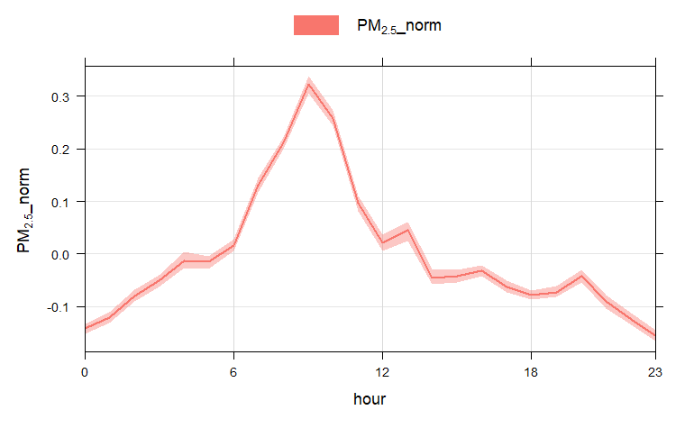
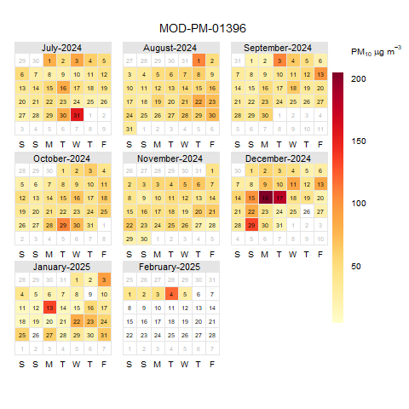
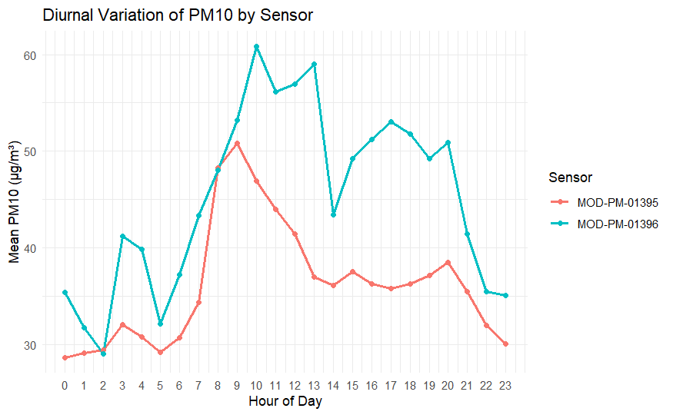
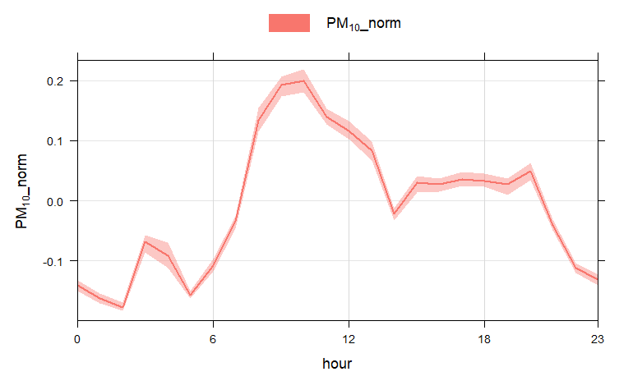
Overview
Elevated PM10 Levels in Galena Park Area
Extreme PM10 Events – December 2024
PM1 and PM2.5 Originate from Different Sources Than PM10
Eastway St
Clinton Dr

Slide 3
Elevated PM10 Levels in Galena Park Area

Slide 4
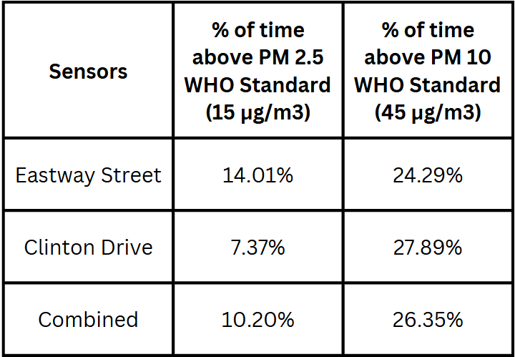
Higher levels of PM10
Eastway St
Clinton Dr
On average, the data shows that PM10 is above WHO guidelines is 2.6x the % of times above PM2.5 guidelines
PM10 is more prevalent towards Clinton Drive (SouthEast) area based on the diurnal

Slide 5
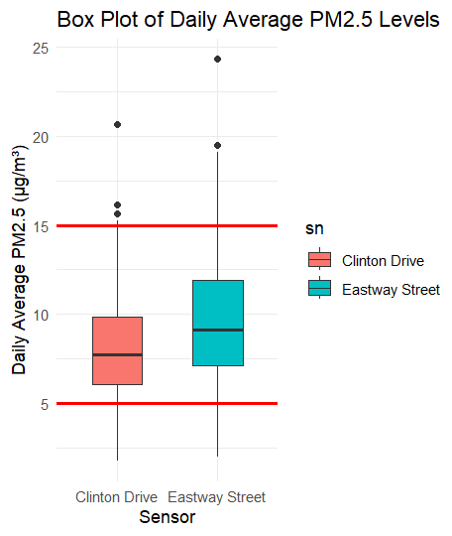
PM2.5 Daily Average
Overall Average: 8.80 µg/m3
Eastway St. : 9.54 µg/m3
Clinton Drive: 8.08 µg/m3
WHO:
  24hr - 15 µg/m3
  Annual - 5 µg/m3
Though this is only 7 months of data, the data is well above the annual guidelines

Slide 6
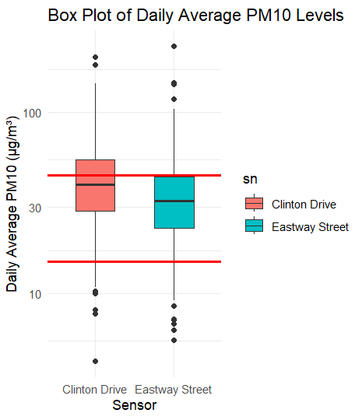
PM10 Daily Average
Overall Average: 41.80 µg/m3
Eastway St. : 38.38 µg/m3
Clinton Drive: 45.23 µg/m3
WHO:
  24hr - 45 µg/m3
  Annual - 15 µg/m3
This data is not only significantly above the annual guidelines, Clinton Drive has an daily average above the 24hr guideline
The PM10 daily average is 2.79 times higher than the annual guideline of 15 units

Slide 7
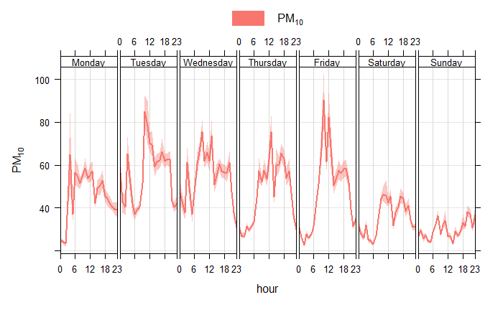
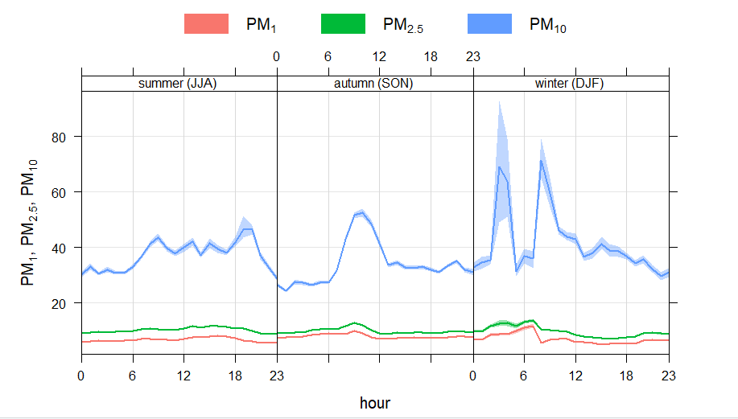
PM10 Diurnals
Noticeable daily peaks, especially during early morning hour

Slide 8
PM10 Events in December 2024

Slide 9
PM10 Diurnals
There were two days that stood out in terms of PM10
They exceed NAAQS’s limit
  150 µg/m3

Slide 10
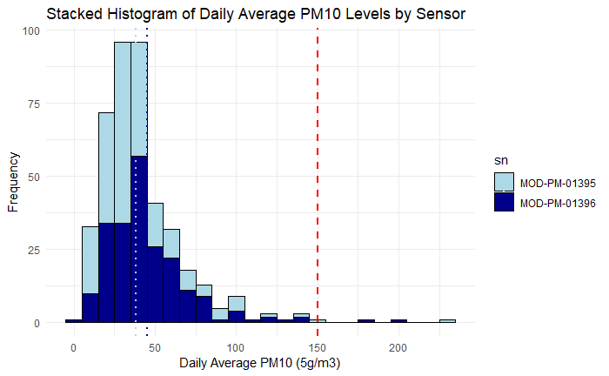
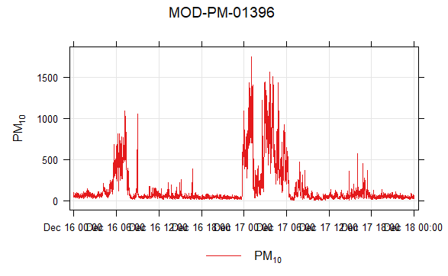
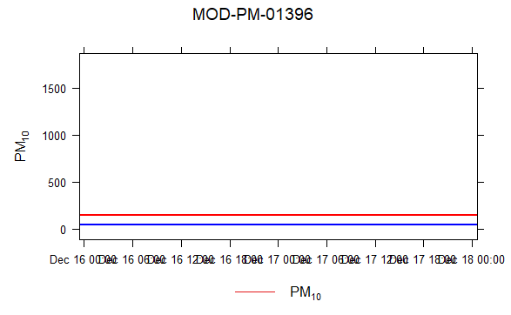
Histogram and Time Series
Eastway St
Clinton Dr
In December 2024, we observed distinct PM10 events with levels often exceeding the EPA 24-hour limit of 150 µg/m³. The time series graph clearly shows sharp spikes—most notably on December 17 and 18—where PM10 levels far surpassed this standard.
Blue line - EPA PM10 Limit

Slide 11
PM1 and PM2.5 Come from Different Sources Compared to PM10

Slide 12
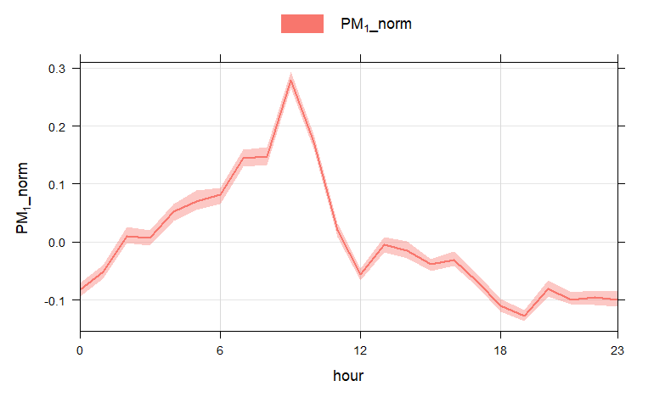
Normalized Diurnals - PM1

Slide 13
Normalized Diurnals - PM2.5

Slide 14
Normalized Diurnals - PM10
Normalized to show the peaks and valleys
PM1 and PM2.5 drop off ∼10am
Not all just rush hour
PM10 doesn’t drop off till late at night

Slide 15
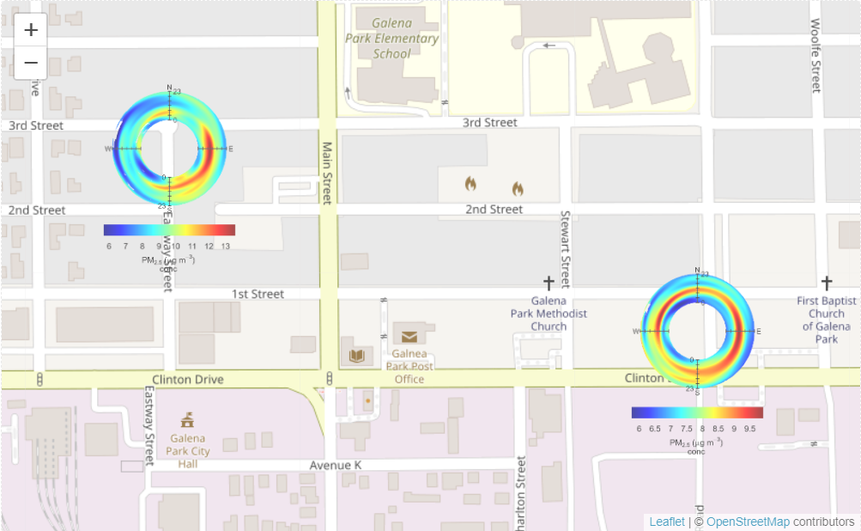
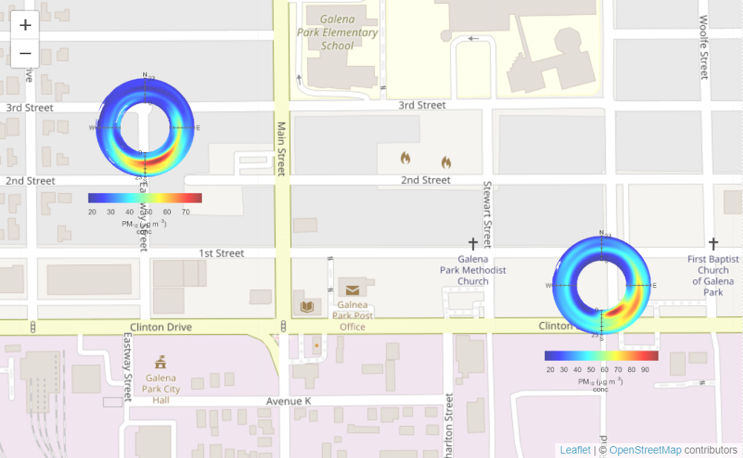
PM 1 & PM 2.5 are coming from different sources
PM 10 tends to come only from the south east, while PM 1 & PM 2.5 come from different places
PM 2.5
VS
PM 10

Slide 16

Direction for Website?
What is the main purpose of the website?
Who is the target audience?
Maintain or switch platforms?

